Slide 1
Unit 1
HUMAN VALUES
Vivek Garg
CSVTU Bhilai

Slide 2
ETHICS
MORALS
VALUES
INTEGRITY
CIVIC VIRTUE
RESPECT FOR OTHERS
COURAGE
CARING
VALUING TIME
COORPORATION
COMMITMENT
EMPATHY
SELF CONFIDENCE
SPRITUALITY
STRESS MANAGEMENT
Sharing
Honesty

Slide 3
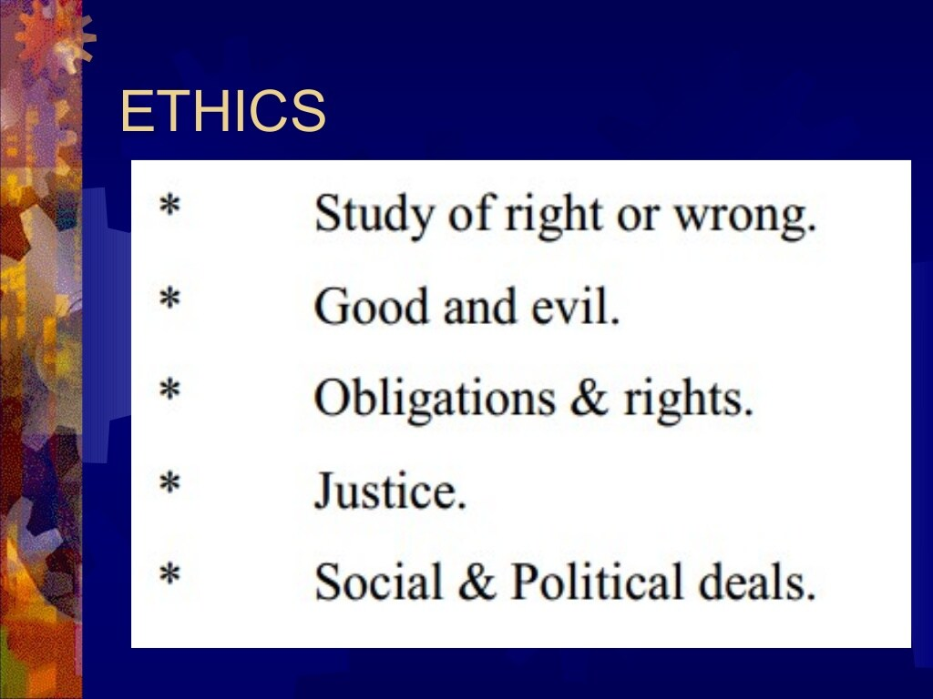

Slide 4
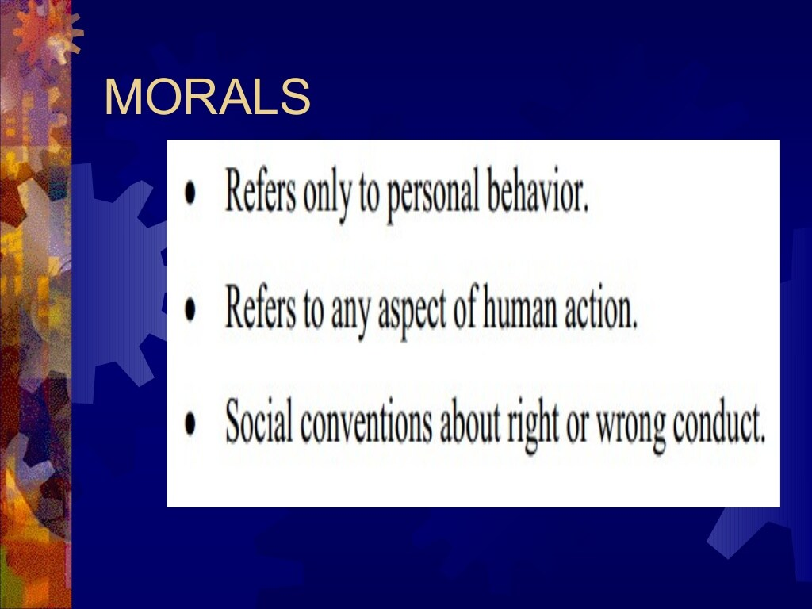

Slide 5
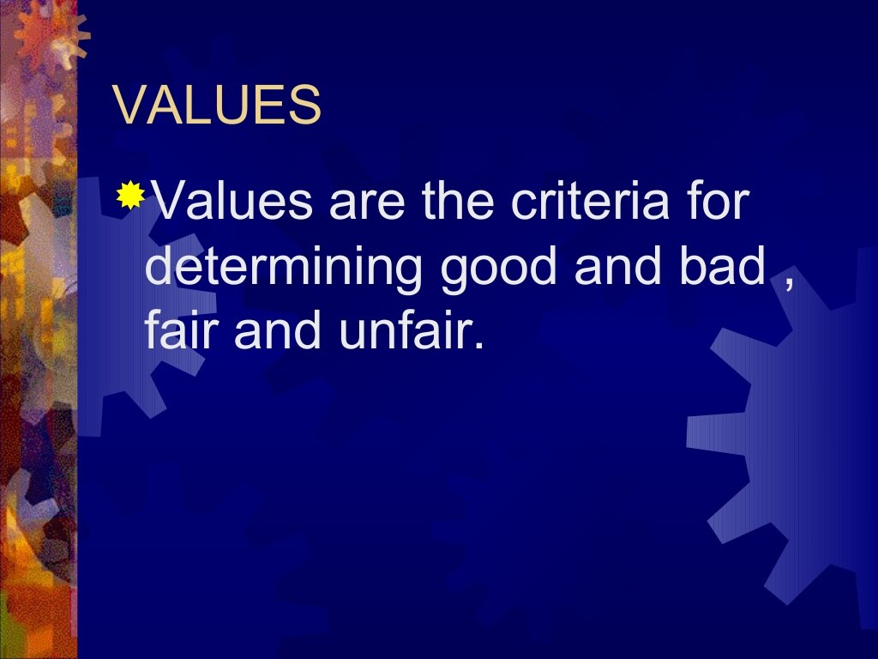

Slide 6
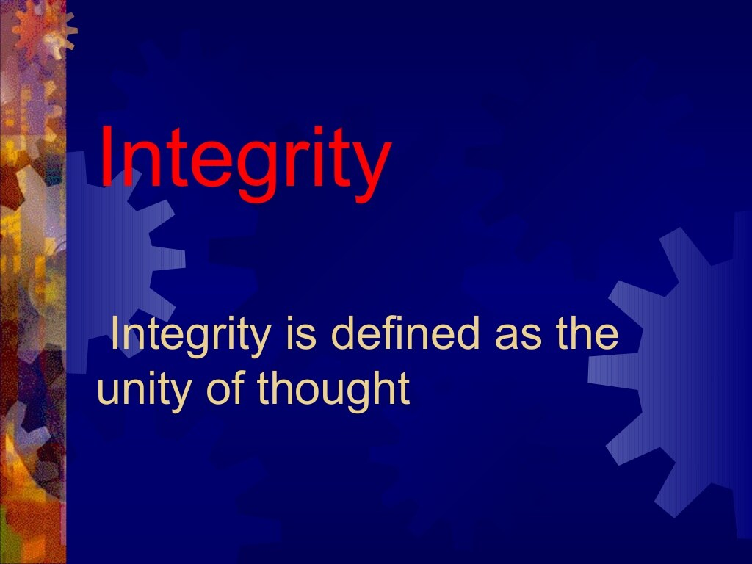

Slide 7
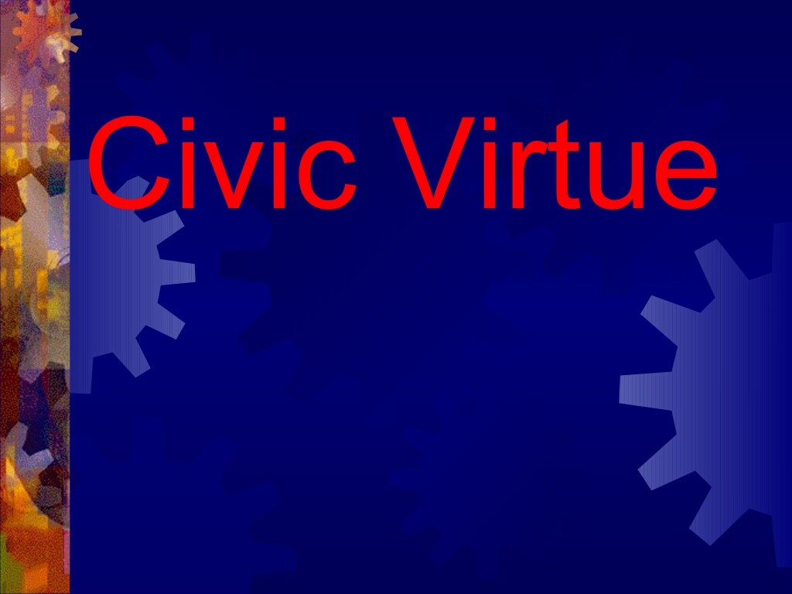

Slide 8
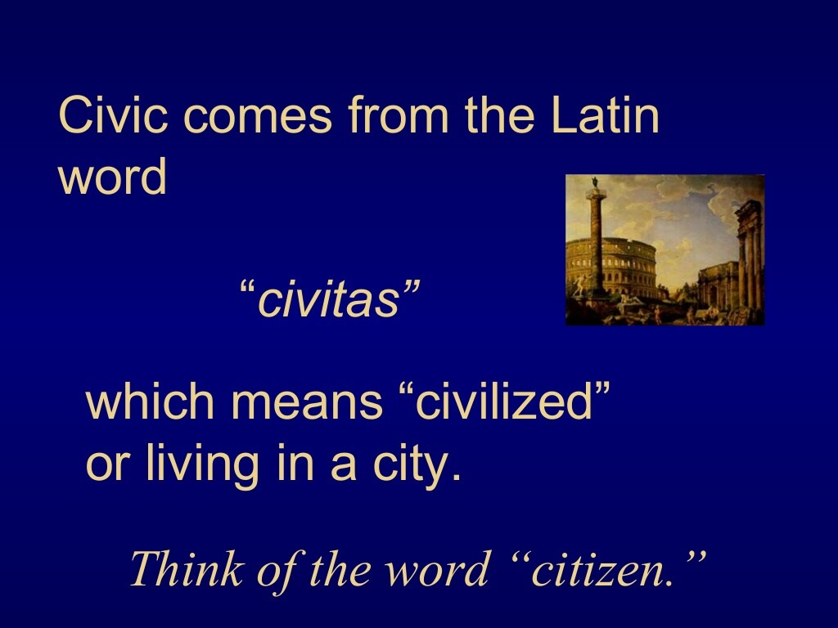

Slide 9
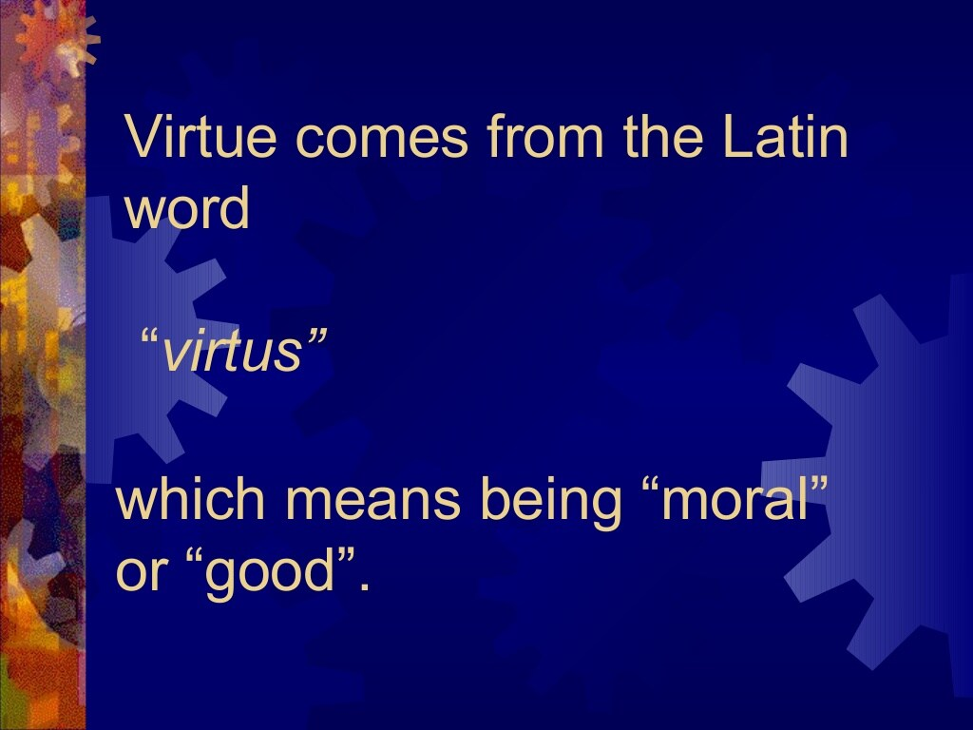

Slide 10
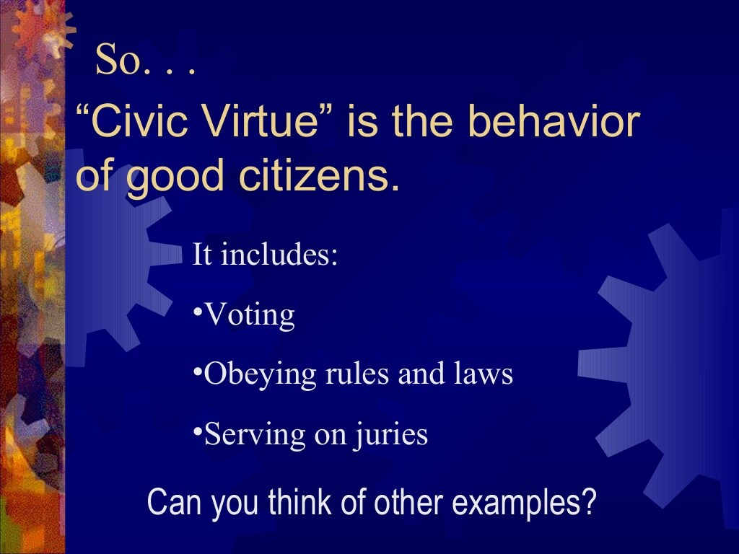

Slide 11
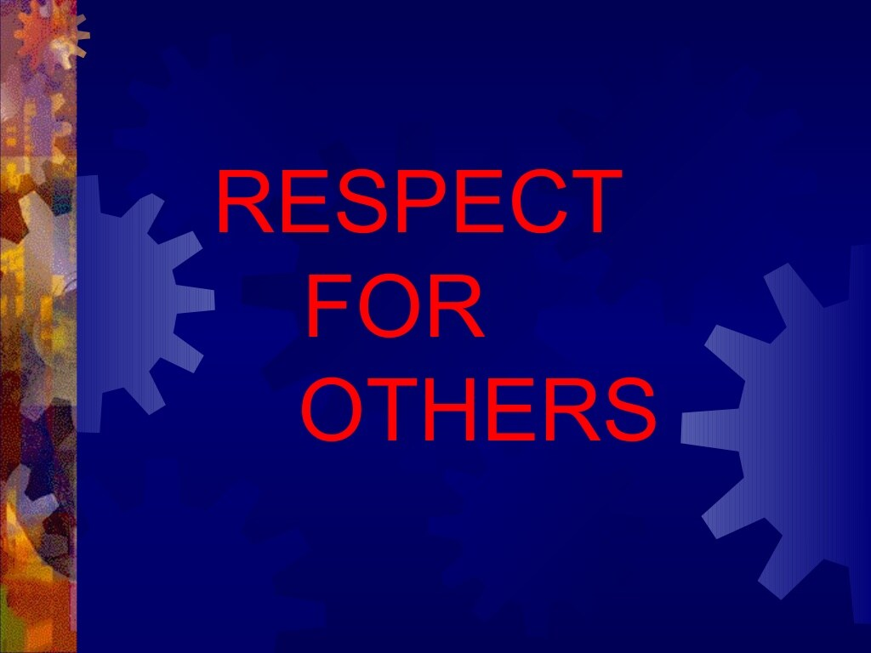

Slide 12
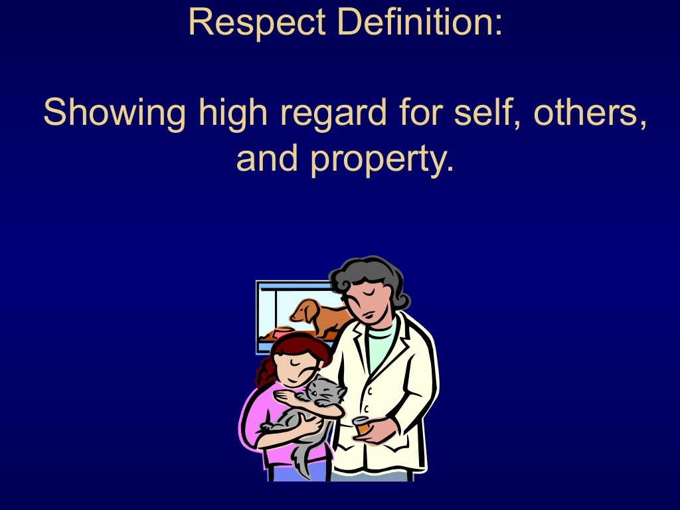

Slide 13
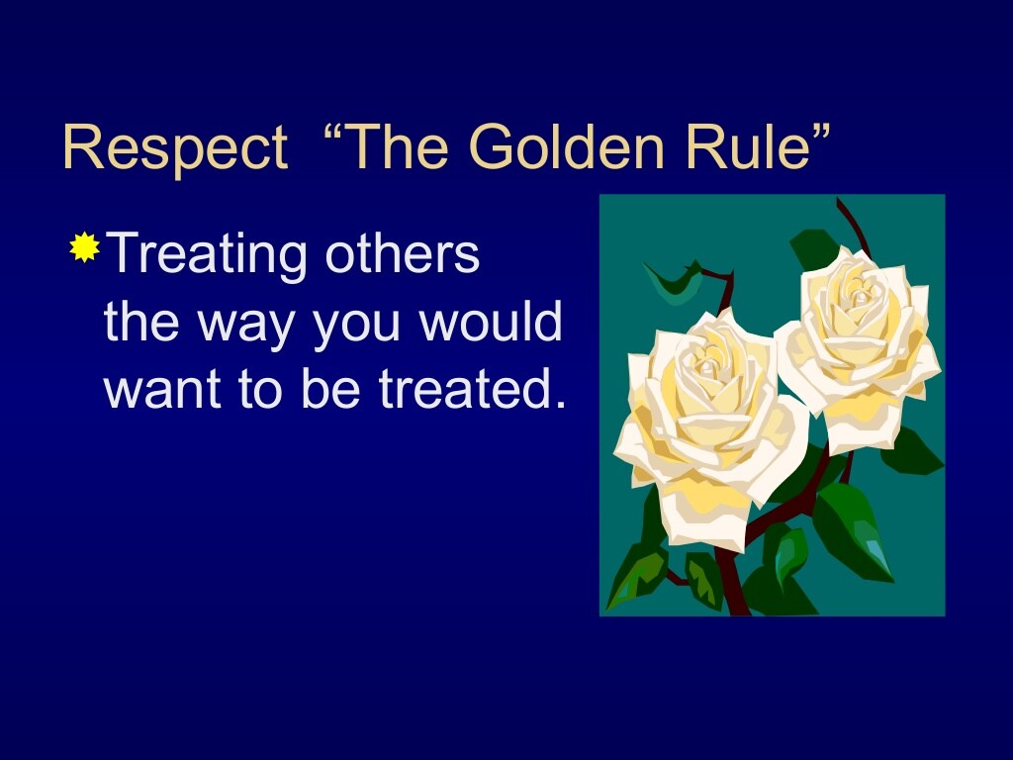

Slide 14
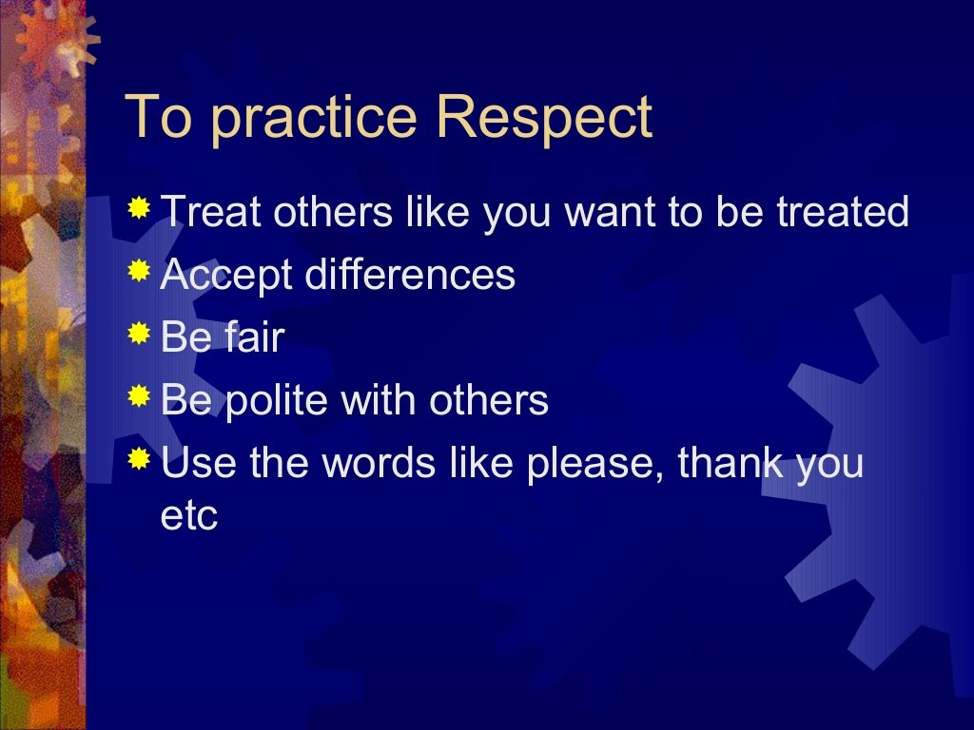

Slide 15
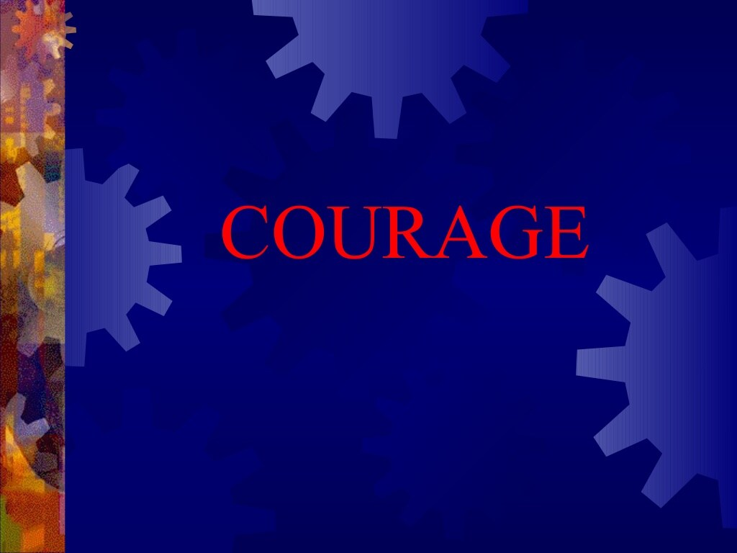

Slide 16
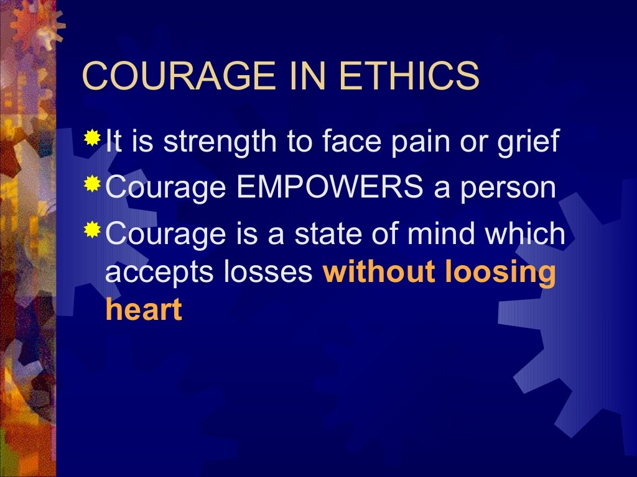

Slide 17
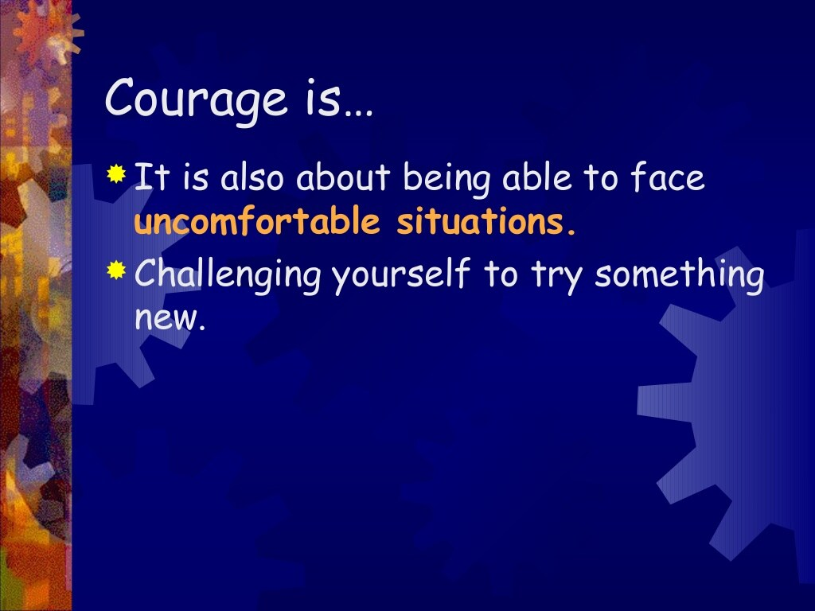

Slide 18
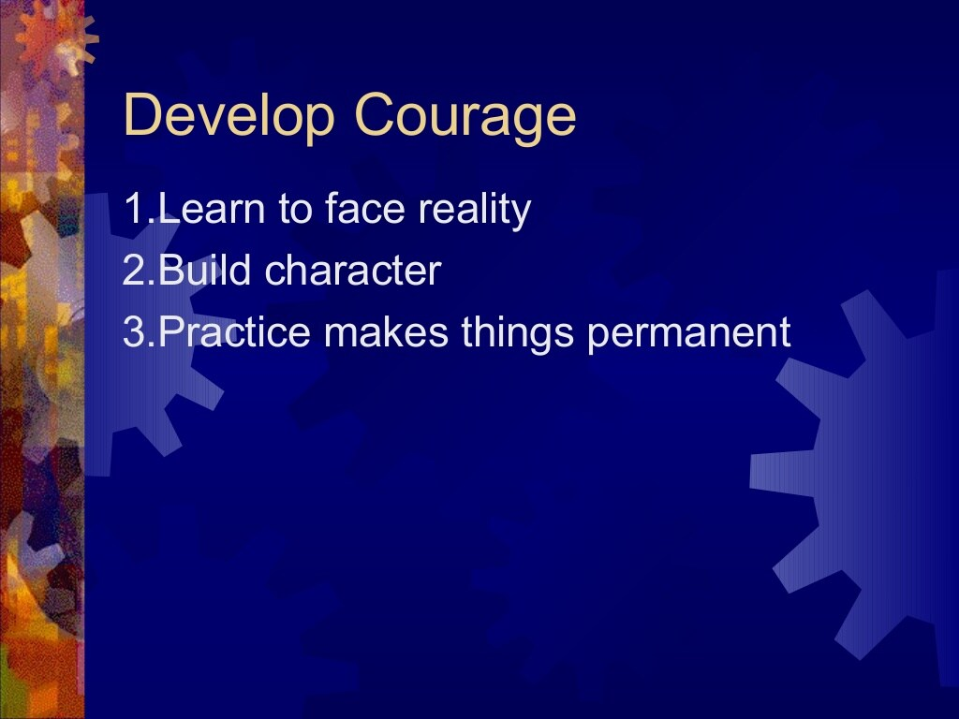

Slide 19
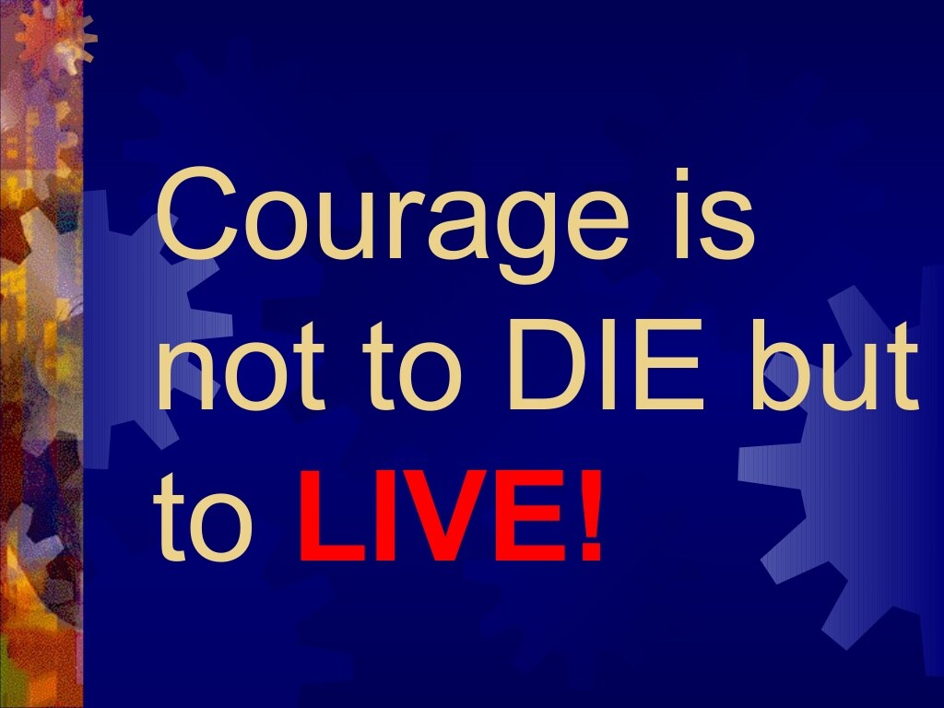

Slide 20
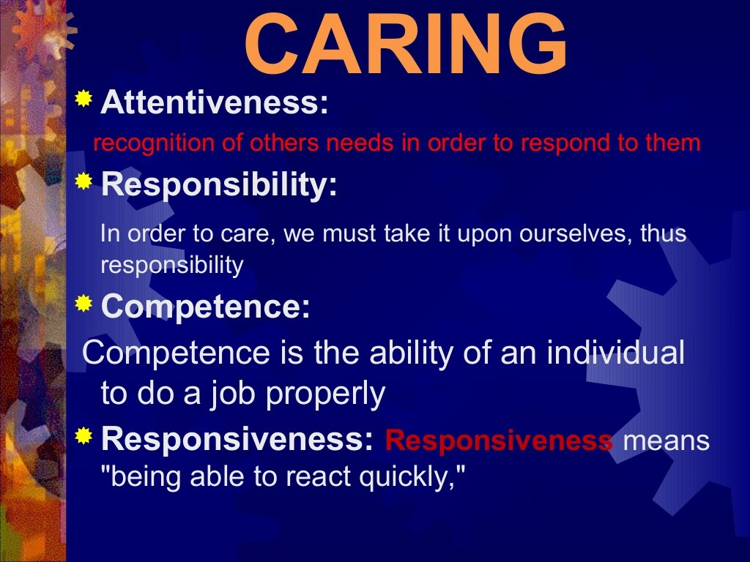

Slide 21


Slide 22


Slide 23
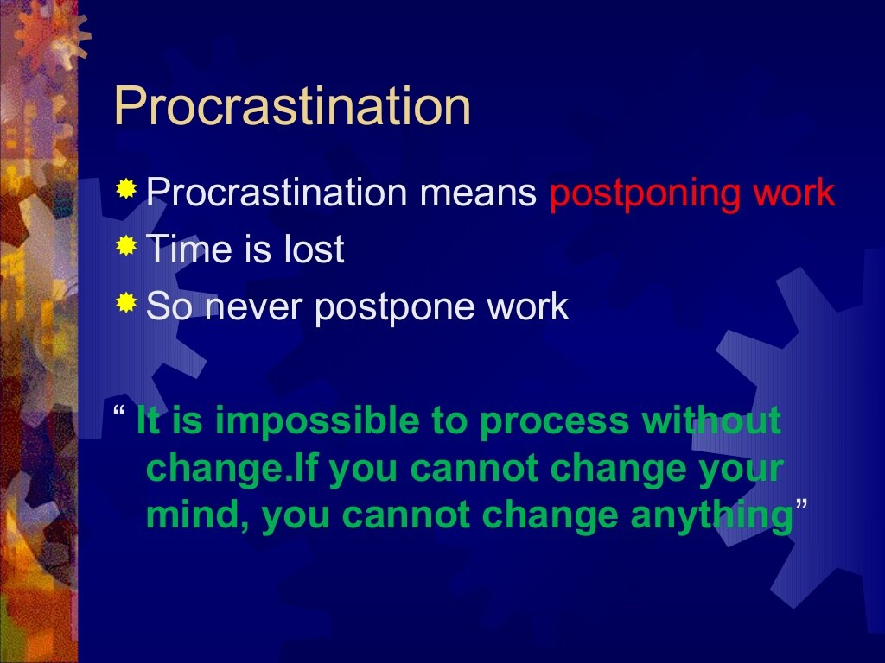

Slide 24
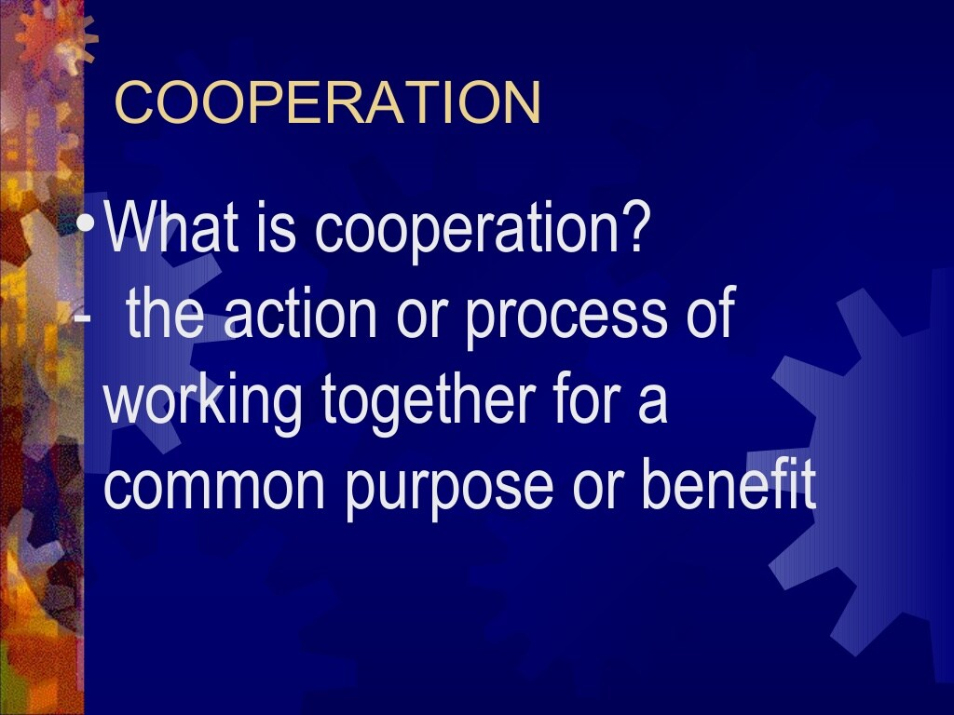

Slide 25


Slide 26


Slide 27
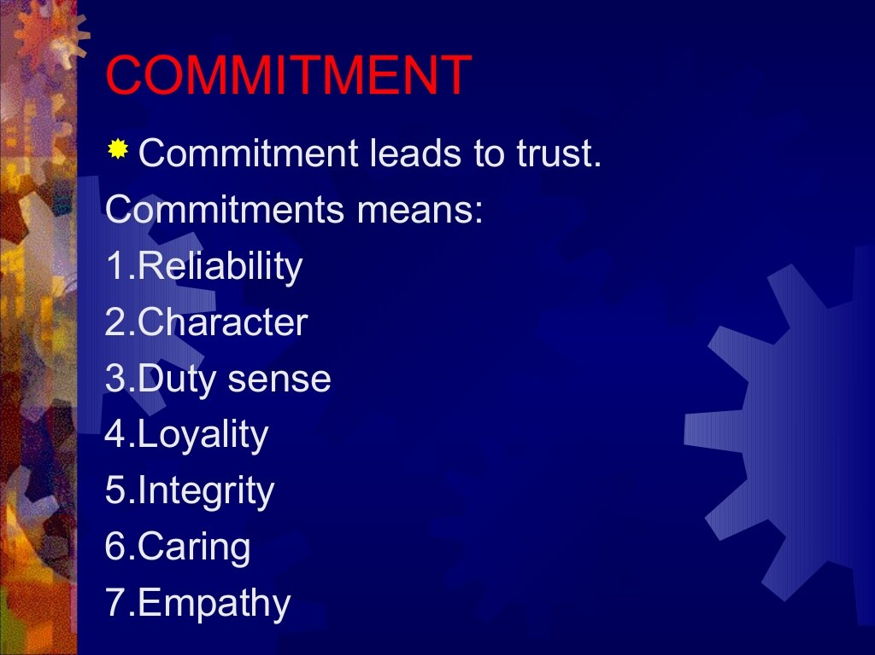

Slide 28
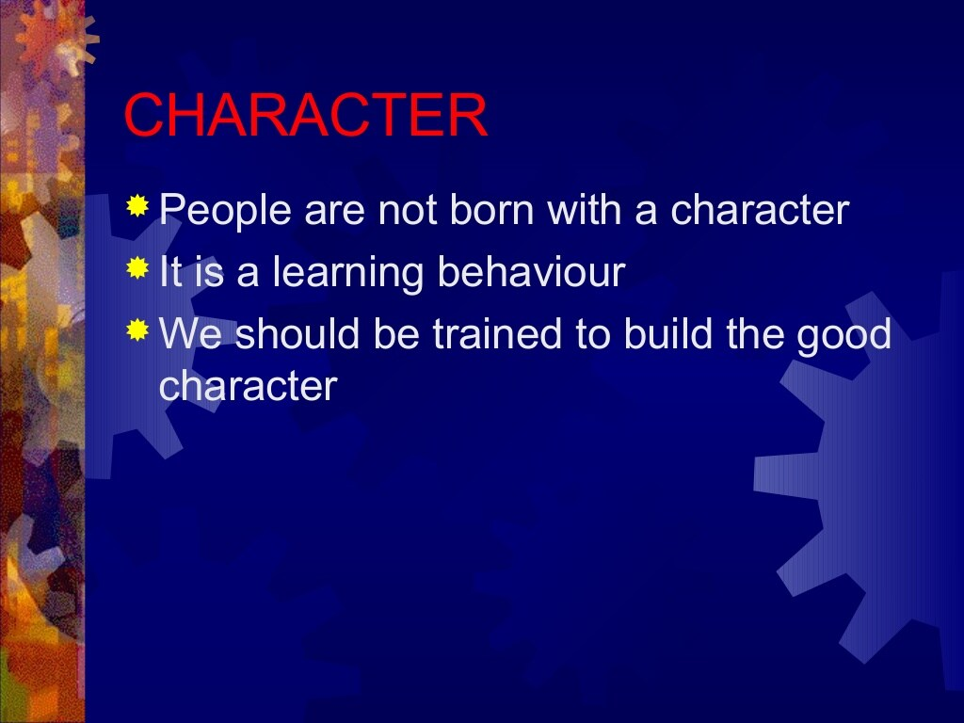

Slide 29
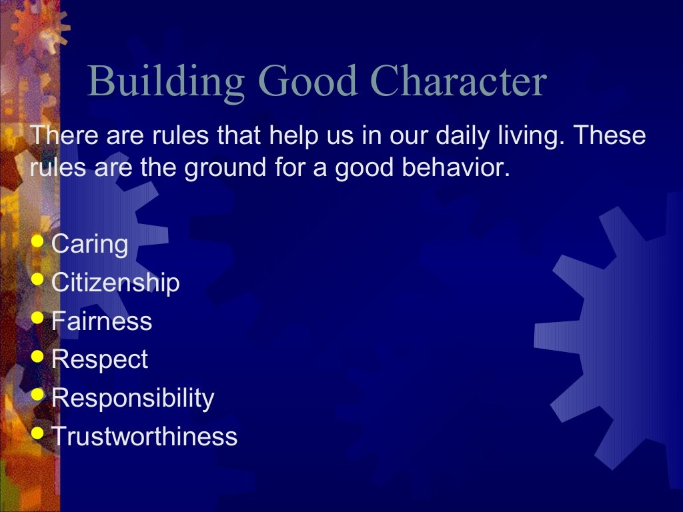

Slide 30
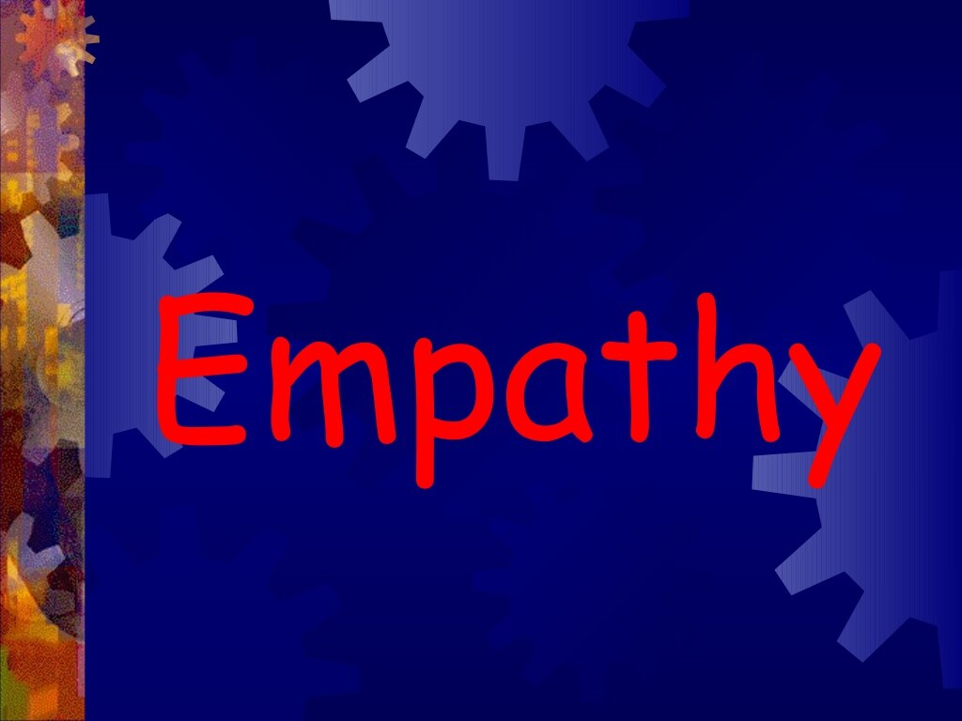

Slide 31
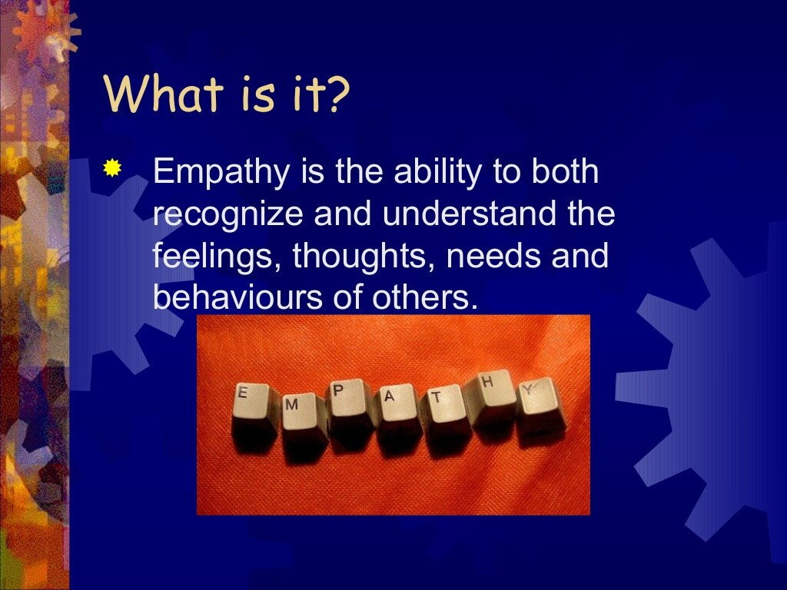

Slide 32
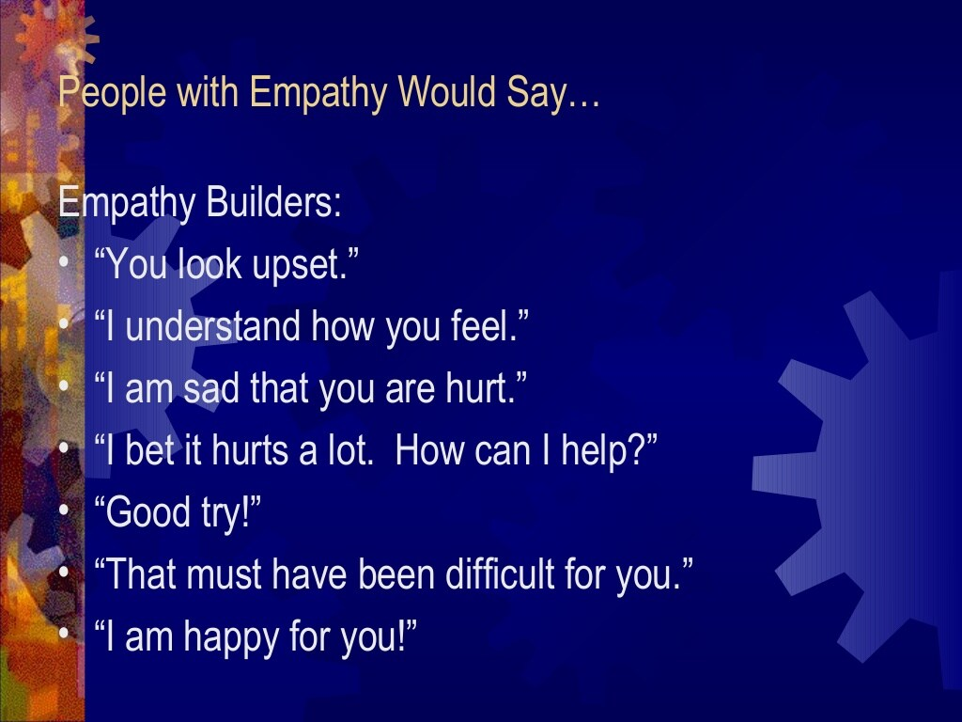

Slide 33
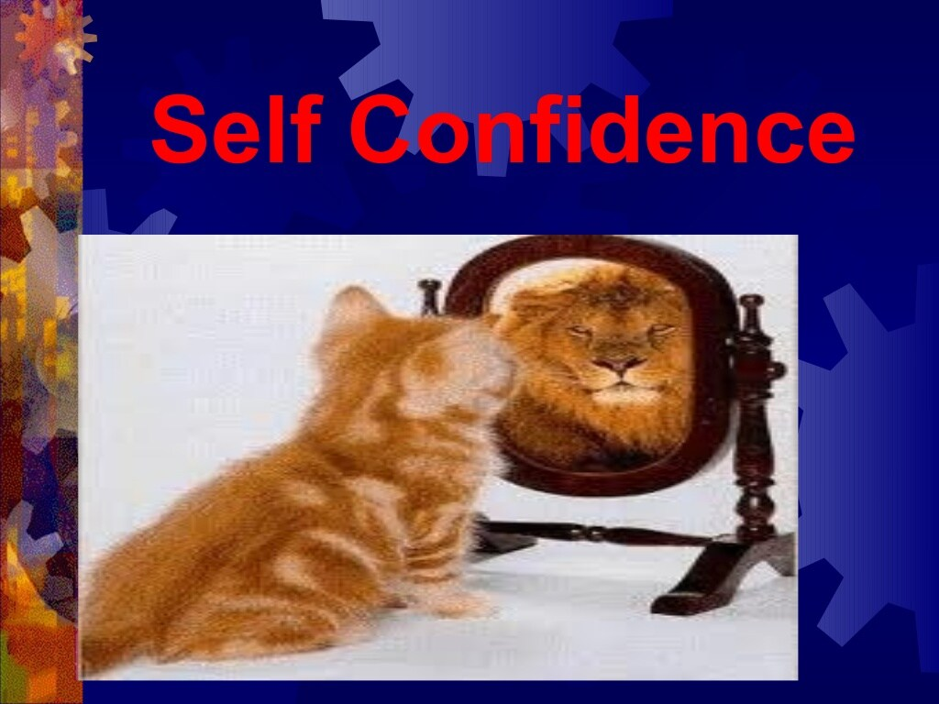

Slide 34


Slide 35
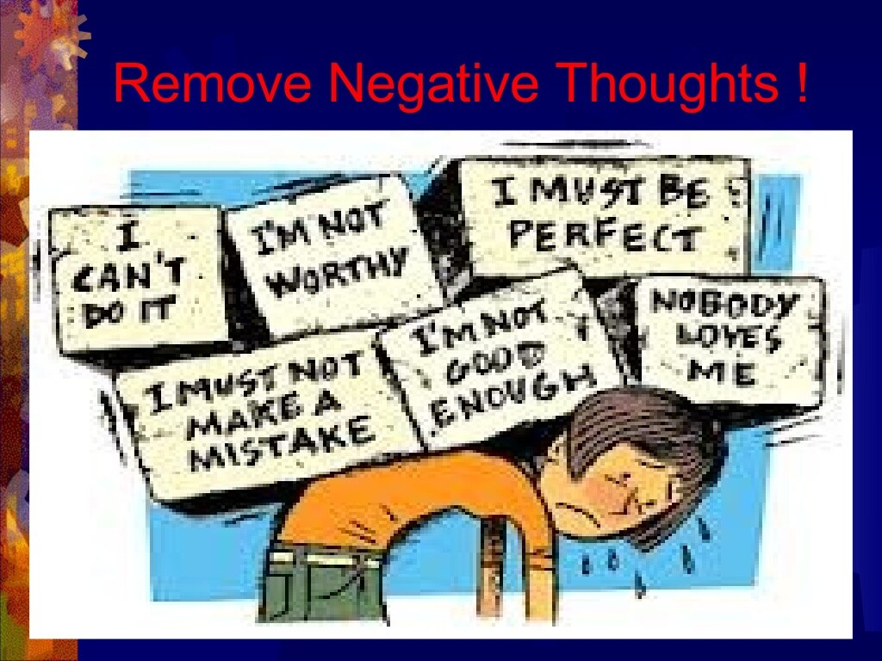

Slide 36
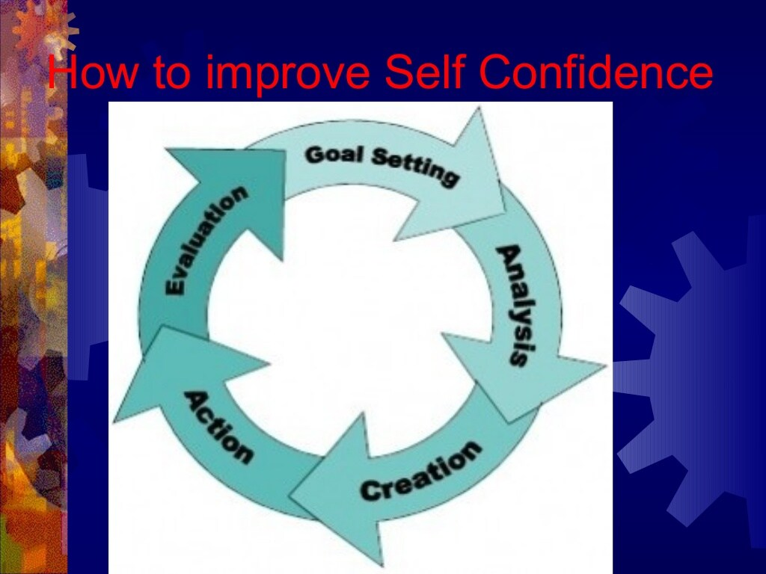

Slide 37
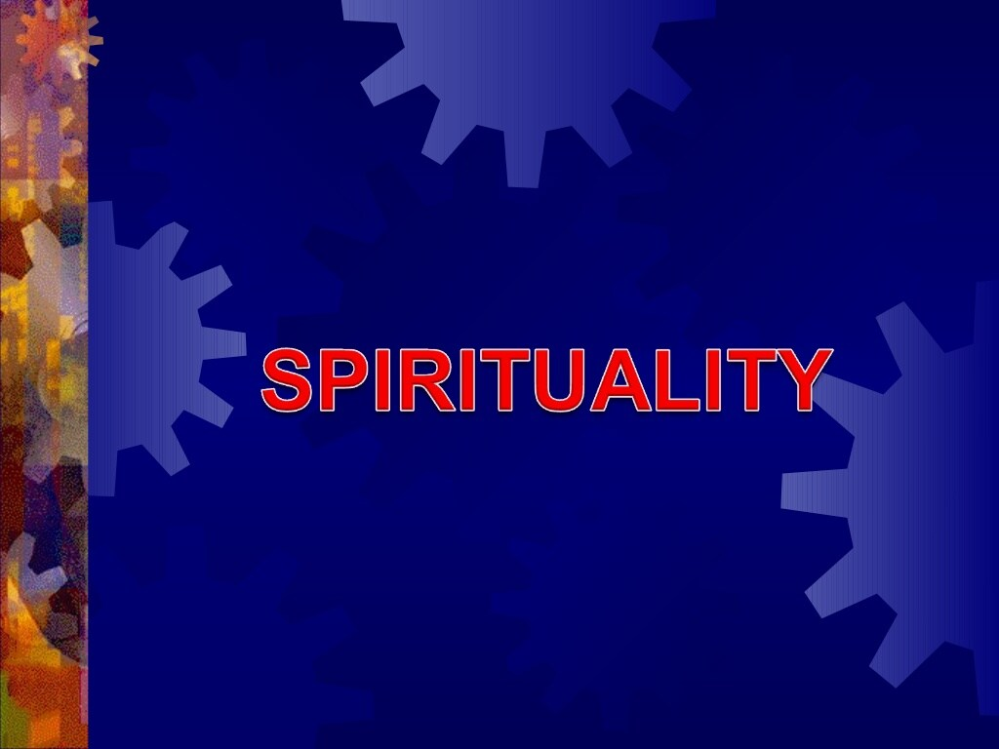

Slide 38
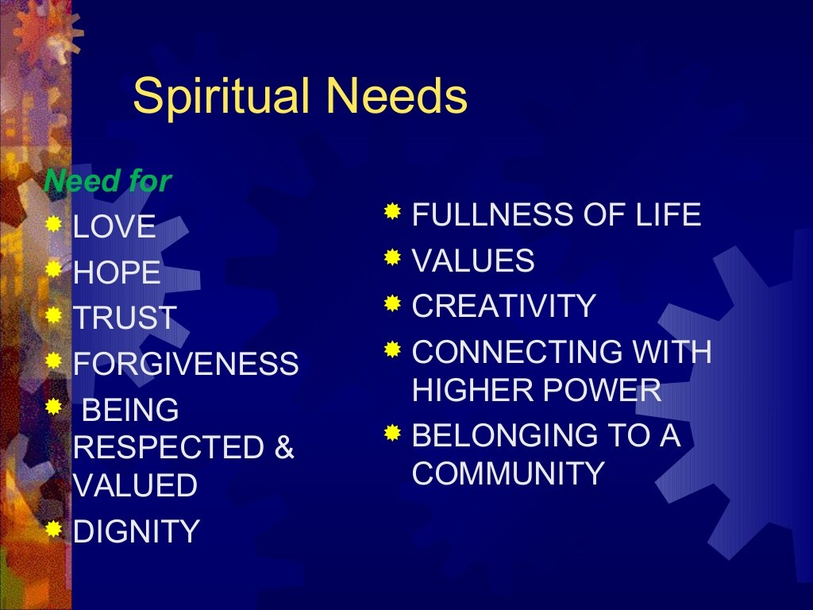

Slide 39
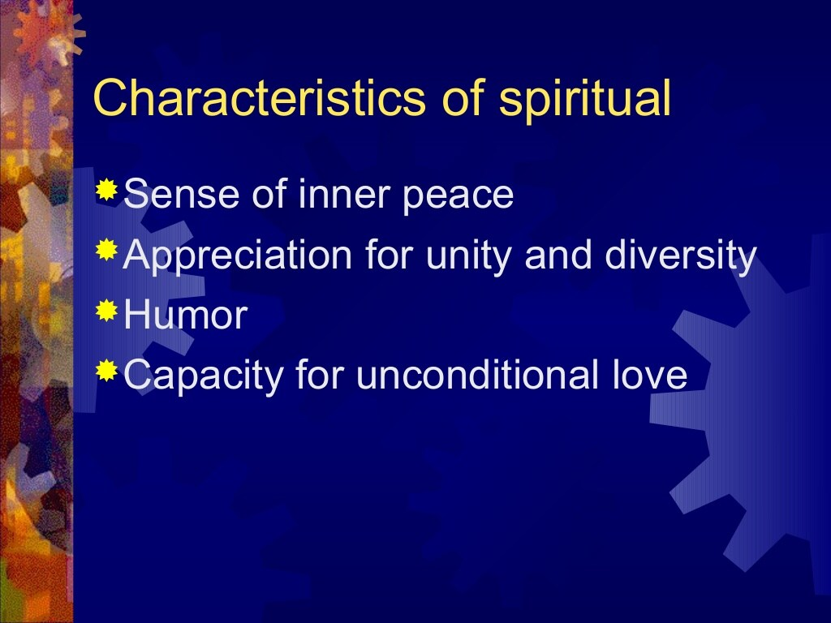

Slide 40
Sharing
Primarily, caring influences ‘sharing’. Sharing is a process that describes the transfer of knowledge (teaching, learning, and information), experience (training), commodities (material possession) and facilities with others. The transfer should be genuine, legal, positive, voluntary, and without any expectation in return. However, the proprietary information it should not be shared with outsiders. Through this process of sharing, experience, expertise, wisdom and other benefits reach more people faster. Sharing is voluntary and it can not be driven by force, but motivated successfully through ethical principles. In short, sharing is ‘charity’.
For the humanity, ‘sharing’ is a culture. The ‘happiness and wealth’ are multiplied and the ‘crimes and sufferings’ are reduced, by sharing. It paves the way for peace and obviates militancy. Philosophically, the sharing maximizes the happiness for all the human beings. In terms of psychology, the fear, divide, and distrust between the ‘haves’ and ‘have-nots’ disappear. Sharing not only paves the way to prosperity, early and easily, and sustains it. Economically speaking, benefits are maximized as there is no wastage or loss, and everybody gets one’s needs fulfilled and satisfied. Commercially speaking, the profit is maximized. Technologically, the productivity and utilization are maximized by sharing.

Slide 41
Honesty
Honesty is a virtue, and it is exhibited in two aspects namely,
(a) Truthfulness and
(b) Trustworthiness.
Truthfulness is to face the responsibilities upon telling truth. One should keep one’s word or
promise. By admitting one’s mistake committed (one needs courage to do that!), it is easy to fix them. Reliable engineering judgment, maintenance of truth, defending the truth, and communicating the truth, only when it does ‘good’ to others, are some of the reflections of truthfulness. But trustworthiness is maintaining integrity and taking responsibility for personal performance. People abide by law and live by mutual trust. They play the right way to win, according to the laws or rules (legally and morally). They build trust through reliability and authenticity. They admit their own mistakes and confront unethical actions in others and take tough and principled stand, even if unpopular.
Honesty is mirrored in many ways. The common reflections are:
(a) Beliefs (intellectual honesty).
(b) Communication (writing and speech).
(c) Decisions (ideas, discretion).
(d) Actions (means, timing, place, and the goals). and
(e) Intended and unintended results achieved.

Slide 42
Character
It is a characteristic property that defines the behavior of an individual. It is the pattern of virtues (morally-desirable features). Character includes attributes that determine a person’s moral and ethical actions and responses. It is also the ground on which morals and values blossom. People are divided into several categories, according to common tendencies such as ruthless, aggressiveness, and ambition, constricting selfishness, stinginess, or cheerfulness, generosity and goodwill. Individuals vary not only in the type of their character but also in the degree. Those whose lives are determined and directed by the prevailing habits, fashions, beliefs, attitudes, opinions and values of the society in which they live have at best a developed social as opposed to an individual character.
The character is exhibited through conduct. Character is determined by the expectations of society. Many act and live within its norms, refusing to fall below the required social minimum, failing to rise above the maximum expected of a normal member of the group. On one extreme are those that do not even conform to the minimum standards, and fail to acquire the socially-required behaviors, attitudes and values. These individuals have an unformed social character. At the other extreme are those whose beliefs, attitudes and values are determined internally by the strength of their own convictions. These are individuals with developed minds and formed characters of their own.

